Slide 1

SmartGuard Project
Presentation II

Slide 2

1. Research Papers
2

Slide 3
User profiling Papers
Adaptive Learning for Complex Thinking: A Systematic Review of Users' Profiling Strategies
Implicit User Profiling in News Recommender Systems
Ontological User Proﬁling in Recommender Systems
An intelligent e-learning system based on learner profiling and learning resources adaptation

Slide 4
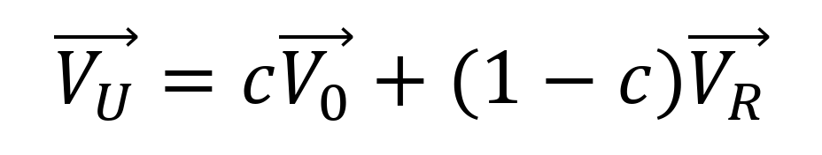
Profiling Types
Static User Profiling
Dynamic User Profiling
Initially creating user profiles based on:
User-Input Data
Initial Assessment
Is a fixed snapshot of the learner that does not change automatically
Updating user profiles based on:
Performance 2) Usage History
3) Interactions 4) Feedback
Updates over time to capture the learner’s changing interests and abilities
New user profile
Running content context
Old user profile

Slide 5
Profiling Types
Static User Profiling
Dynamic user Profiling
Initially creating user profiles based on:
User-Input Data
Initial Assessment
Is a fixed snapshot of the learner that does not change automatically
Updating user profiles based on:
Performance 2) Usage History
3) Interactions 4) Feedback
Updates over time to capture the learner’s changing interests and abilities
A constant that ranges from 1 (no context) to 0 (old profile is no longer relevant)
Assuming that: Old interests fade unless they are renewed

Slide 6
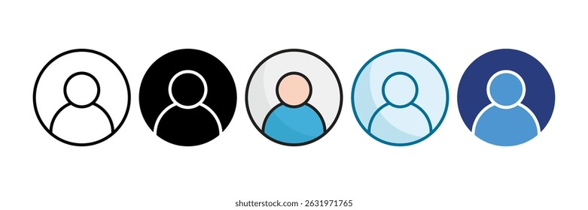
2. Database Schema
6

Slide 7
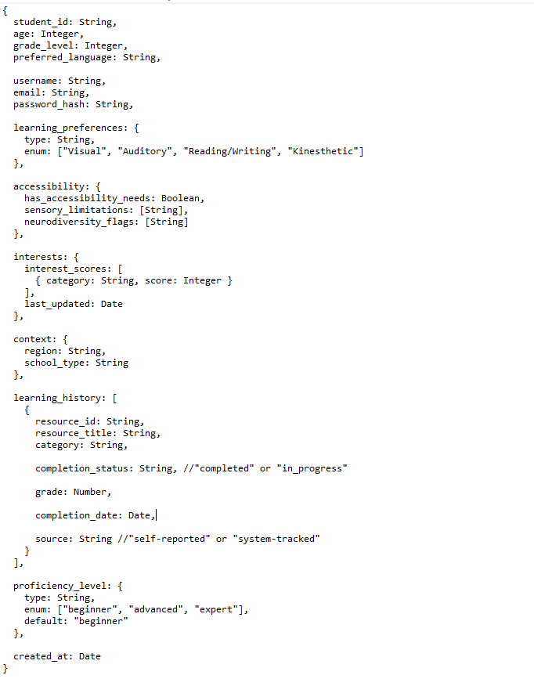
A) Student Profiles
System generates an ID for each user (ObjectID)
Users input their personal information:
Age
Grade Level
Preferred Language
Username
Email
Password (which the system stores as a hashed code)
- Context (region & school type)

Slide 8
A) Student Profiles
Users choose their preferred learning style from:
Visual Resources
Auditory Resources
Reading/Writing
Kinesthetic (by touching materials)
They can also indicate whether they have any accessibility issues either:
- Sensory limitations
- Neurodiversity

Slide 9
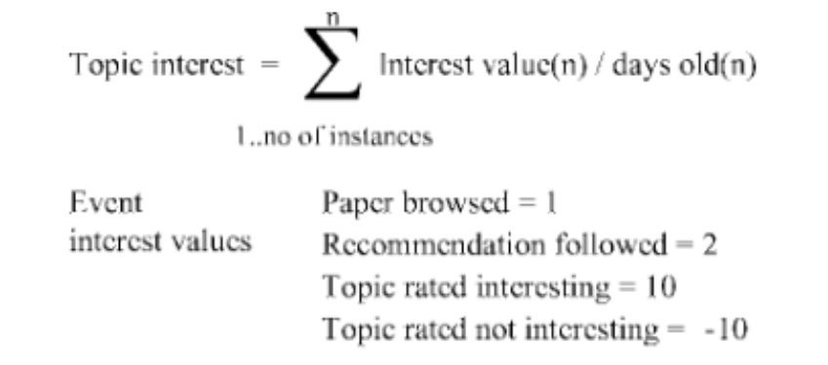
A) Student Profiles
Users input their interests and how much they rate their interest level
The score is calculated from both:
The user’s input
A time decay function (to favor newer interests over much older ones)
from users’ feedback after completion

Slide 10
A) Student Profiles
Additionally, the database stores all the resources that the user had completed and/or is currently taking as well as:
- The category of the resource
The grade the user got
The (expected) completion date
The proficiency level is then calculated using the user’s performance to determine whether it is:
- Beginner
Advanced
- Expert

Slide 11
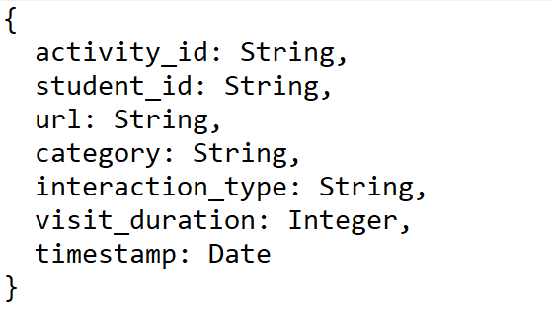

B) Browser Activity
System generates an activity ID (ObjectID)
This table stores each student (student_id) along with each webpage they visited (url)
Additionally, we store the type of interaction performed such as:
Viewing (opening the webpage)
Scrolling (engaging with the webpage)
Clicking (interacting with the webpage)
Finally, we store the duration & time of each visit
Note that: if the same webpage is visited twice by the same student, it will have two separate entries

Slide 12
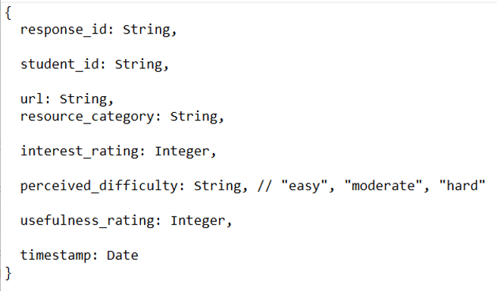
C) Feedback Responses
After completion, an e-questionnaire is submitted by the user about their learning experience
Users give a rating of:
How much they found it interesting
How much they found it useful
They also submit the degree of difficulty of which they found the learning resource
Finally, the table also stores:
The category of the resource/webpage
The time at which the feedback was submitted

Slide 13

THANK YOU
Insert Image

